Slide 1



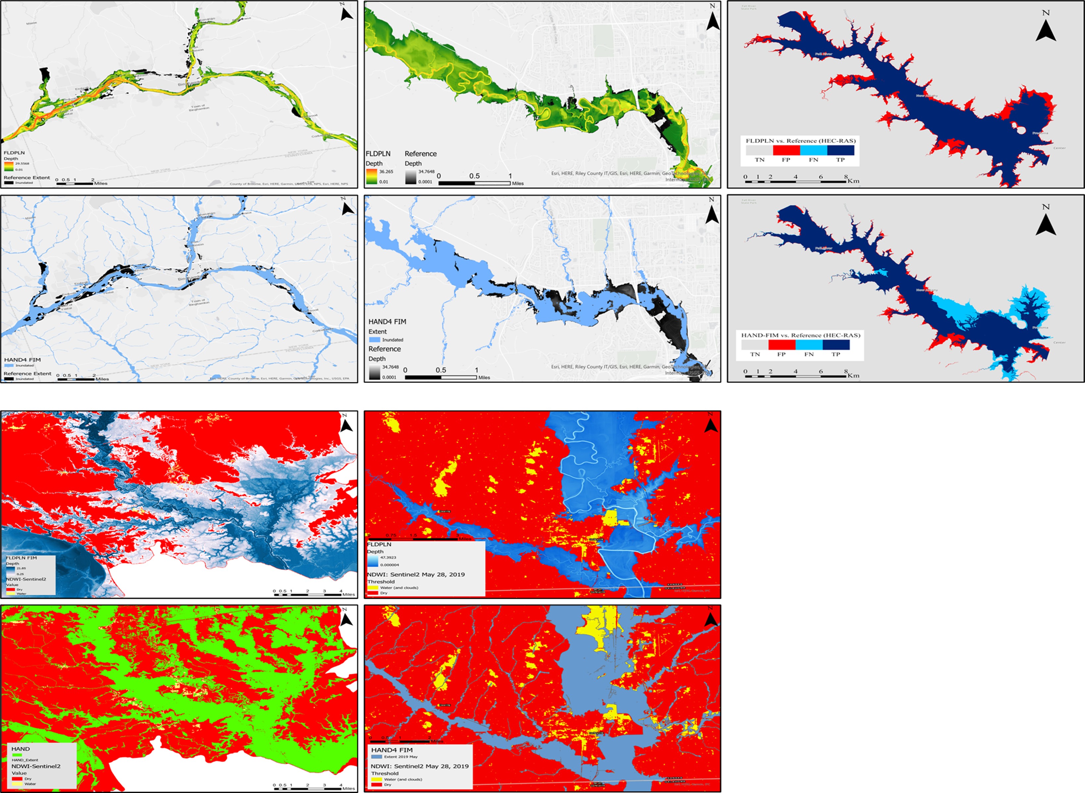
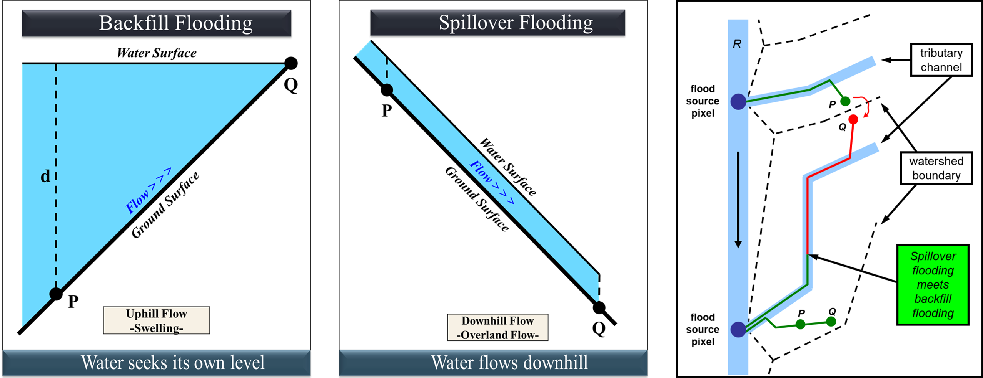
Evaluating FIM Models for Accurate Flood Inundation:
Comparative Case Studies with FLDPLN
James Halgren^{1,2}, Junho Song^{1,2}, Reza Alipour², David Weiss^{4,5}, Jack Edwards^{4,5}, Jude Kastens^{3,4,5}, Xingong Li^{4,5}, Kenneth Ekpetere^{3,5}, Jim Coll^{5,6}
[1] Alabama Water Institute, [2] University of Alabama, [3] Kansas Biological Survey and Center for Ecological Research, [4] Kansas Applied Remote Sensing, [5] University of Kansas, [6] Lynker
Introduction
The FLDPLN (Floodplain) is a low-complexity and computationally efficient for Flood Inundation Mapping (FIM). However, in addition to the per-pixel nature of the computation, it considers not only Backfill flow but also Spillover flow mechanism to improve flood mapping accuracy by minimizing disconnection of flow via new flow route development.
This study compares FLDPLN and the other FIM models to assess their accuracy in flood extent and depth mapping. By evaluating case studies including (1) Susquehanna River, NY., (2) Wild Creek, KS., (3) Verdigris River, KS., (4) Amite River Basin, AL., (5) Buffalo Bayou, TX., (6) Turkey River, IA., the study highlights how FLDPLN’s approach can enhance flood prediction in diverse regions.
Comparative Case Studies
FLDPLN with gauges. HAND with NWC SRC stages (NWM v2.1). Ref. NYSEG aerial survey.
Both with NWM Retrospective v2.1 and NWC SRC stages. Ref. AHPS inundation map (HEC-RAS).
Both with NWM Retrospective v2.1 and NWC SRC stages. Ref. HEC-RAS.
FLDPLN with gauges. HAND with NWC SRC stages (NWM v2.1). Ref. Sentinel-2.
Both with NWM Retrospective v2.1 and NWC SRC stages. Ref. Sentinel-2.
FLDPLN Methodology
The FLDPLN utilizes the Digital Elevation Model (DEM) as the primary data source for constructing the inundation library with real-time stream elevations being used to access the library and generate flood extent.
In the FLDPLN algorithm, when the computation encounters internal sub-watershed divides, it does not halt the flooding process as HAND does. Instead, water is allowed to spill over these divides, thereby inundating areas beyond the divide.
Via iterative calculations, the spillover contributes to additional backwater flooding until a steady state is achieved.
It offers a continuous and natural representation of flooding, leading to accurate and adaptable method.
(A) Susquehanna River (NY)
(B) Wildcat Creek (KS)
(C) Wildcat Creek (KS)
References
[FLDPLN]
http://hdl.handle.net/1808/5354
[FLDPLN GIT]
https://github.com/XingongLi
https://github.com/AlabamaWaterInstitute/FLDPLN
(D) Amite River (LA)
(E) Verdigris River (KS)
Results and Discussion
FLDPLN demonstrated high accuracy in predicting flood extent and depth across diverse case studies. Its ability to interpolate stages between FLDPLN-based Synthetic Rating Curves (SRC) contributed to reliable results for both small and large-scale flood events.
The spillover mechanism allowed for a more realistic representation of water flow across internal boundaries, improving flood spread predictions in complex terrains. This feature enhanced flood extent mapping in inter-tributary areas, surpassing other models’ limitations.
FLDPLN provides a more accurate connection between proxy gauges and mapping methods including HAND4 FIM, enabling seamless application in varying topographical and meteorological conditions. The model delivered consistent results even in challenging floodplain areas with diverse terrain.
Conclusion
Summary of Key Findings
FLDPLN-based SRCs significantly enhanced flood inundation predictions, providing a more accurate representation of flood extent and depth. The use of these SRCs together with remote sensing proxy gauges allowed FLDPLN to interpolate data effectively, improving adaptability to various hydrological conditions and ensuring reliable predictions in complex landscapes.
Future Directions
Future enhancements will focus on optimizing the development of FLDPLN-based SRCs to further refine flood mapping accuracy. By developing robust algorithms for SRC integration and processes, we aim to enhance the model's predictive capabilities. This approach will facilitate better management of intricate drainage systems and allow for the seamless incorporation of real-time data, thereby improving flood forecasting precision across diverse scenarios.
Acknowledgment
This research was supported by Administration NOAA, through the NOAA Cooperative Agreement with The University of Alabama (NA22NWS4320003). We thank the 2024 Summer Institute SHARP-FIM group for their contributions.

